Slide 1

ARCHITECTURE & DESIGN
Blend360 Assistant
Autonomous Multi-Agent System for Scalable Analytics

Slide 2


Executive Summary
The Solution
The Challenge
An autonomous Agentic RAG system. We separate the "Brain" (LLM) from the "Memory" (Database). Using PostgreSQL for storage and LangGraph for reasoning, we deliver accurate, hallucination-free insights.
Retail datasets are massive (100GB+) and complex. Executives need instant answers without writing SQL. Traditional chatbots hallucinate on math and cannot handle large-scale aggregations.

Slide 3







System Architecture
Frontend
Orchestration
Data Layer
Streamlit UI provides a chat interface and an "Ingestion Wizard" for uploading CSVs and defining metadata context.
FastAPI + LangGraph. The API handles state, while the graph manages the cyclic agent workflow (Generate -> Execute -> Validate).
PostgreSQL stores the 100GB+ sales data. FAISS stores vector embeddings of past queries (RAG) to guide the LLM.

Slide 4
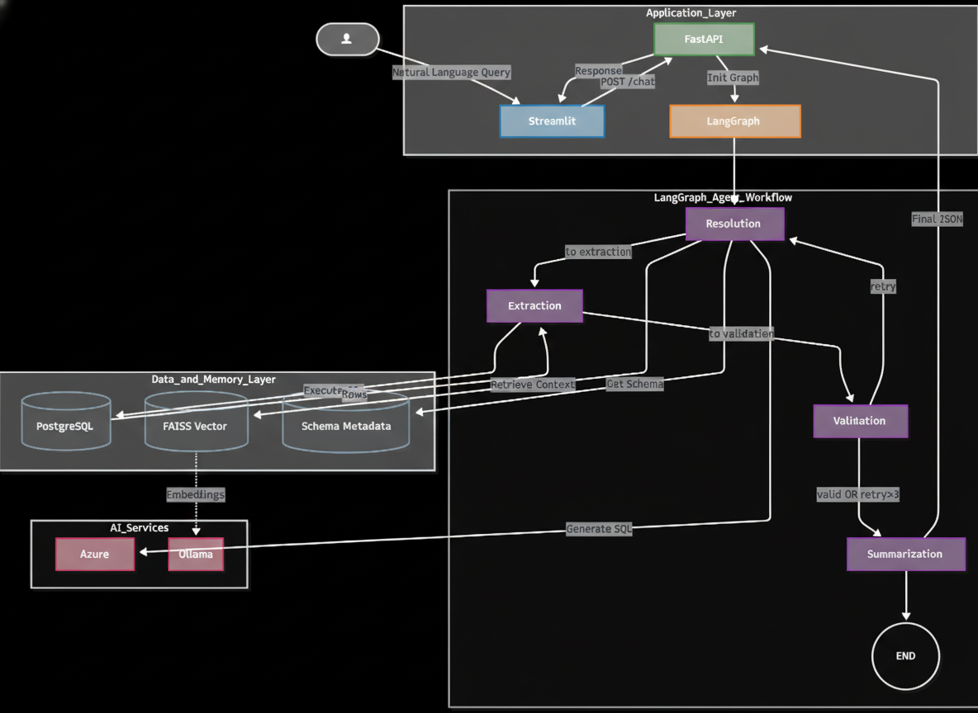
System Architecture

Slide 5
Scaling to 100GB+
No In-Memory Loading: We strictly avoid loading CSVs into Pandas. We use SQL for all aggregations, leveraging the database engine's optimization.
Partitioning & Indexing: The Postgres schema uses indices on `region`, `date`, and `product_id` to ensure sub-second query times even on billion-row tables.
Recursive Summarization: For result sets >1000 rows, we don't stuff the context window. We use a Map-Reduce pattern to summarize chunks in parallel.

Slide 6






The Agentic Graph
1. Resolution Agent
2. Extraction Agent
3. Validation Agent
4. Summarisation Agent
Receives user query. Retrieves "Golden SQL" examples from FAISS. Generates the SQL query based on the schema.
Executes the SQL against Postgres. Handles database connection errors but does not interpret the data yet.
Checks if data is empty or if SQL failed. If invalid, it loops back to Agent 1 with the error message for self-correction.
Break data into chunks, summarize them in parallel, and combine the outputs into one coherent summary.
Built using LangGraph StateGraph with Conditional Edges

Slide 7
RAG for Accuracy (Few-Shot)
Rag For Accuracy (Few-Shot)
Context, Not Content
We do NOT store the 100GB sales data in the Vector DB. Vector search is poor at aggregation (math).
What we store in FAISS:
Golden SQL Examples: "How to calculate YoY growth" (Complex SQL logic).
Schema Metadata: Descriptions of ambiguous columns (e.g., "amt_1" = "Q1 Revenue").
This retrieves the logic needed to solve the problem, then applies it to the raw data in Postgres.

Slide 8
Handling Large Results (Map-Reduce)
The Map-Reduce Solution
The Problem
Step 1 (Map): Split data into chunks of 1000 rows. Use ThreadPoolExecutor to summarize all chunks in parallel.
A query like "List all transactions in the West region" might return 5,000 rows. Passing this to GPT-4o is expensive and exceeds context limits.
Step 2 (Reduce): Feed the 5 mini-summaries into a final prompt to synthesize a cohesive answer.

Slide 9
Query Pipeline Trace
RAG Retrieval
Execution
Fetch schema & similar SQL
Agent 2 queries Postgres
User Query
SQL Generation
Summarization
"Sales trend in North?"
Agent 1 writes SELECT...
Agent 4 describes data

Slide 10
Future Roadmap
Model Garden: Implement Model garden to give more feasibility to user to select model as per use case.
Dynamic Visualization: Agent that generates Python Plotly code to render interactive charts in Streamlit.
Streaming Responses: Implement Server-Sent Events (SSE) in FastAPI to stream tokens to the UI.
RBAC Security: Implement Row-Level Security in Postgres to ensure users only see their region's data.
User Feedback Loop: Allow users to "Thumbs Down" answers, which automatically saves the failed query for fine-tuning.

Slide 11
Thank you for your time.

